Slide 1
U-net Pet -Segmentation
Mini project

Slide 2
Motivation
After seeing Video Filters in zoom meeting
Video background changing
Can it be done using segmentation?
How to train this type of network?

Slide 3
Objective
Pet image
Segmented output

Slide 4
Oxford-IIIT pet dataset
The Oxford-IIIT pet dataset is a 37 category pet image dataset with roughly 200 images for each class. The images have large variations in scale, pose and lighting.
All images have an associated ground truth annotation of breed.
Available with tensorflow dataset

Slide 5
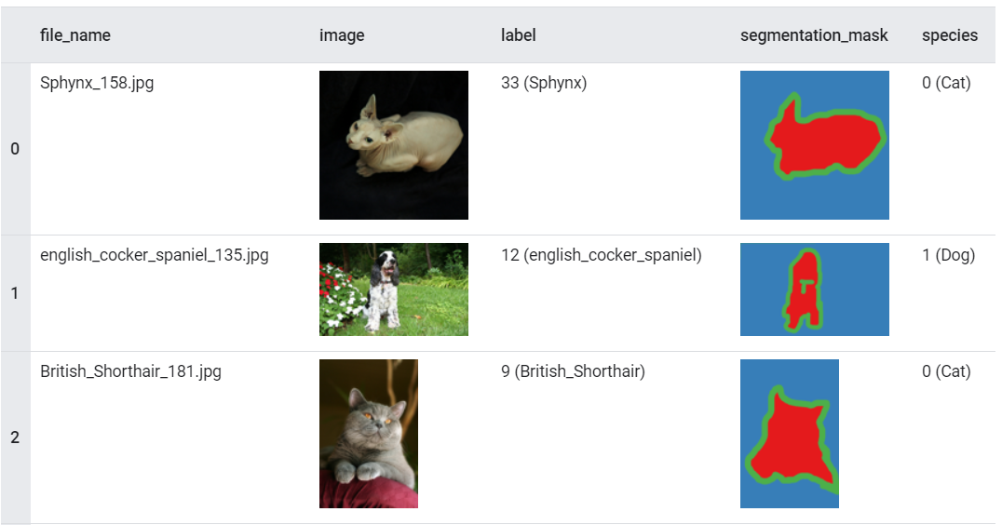
Dataset preview

Slide 6
Chosen 3 Output Classes
Pet
Background
Border

Slide 7
Preprocessing
Data Augmentation
Uniform flipping
Input image and its ground truth label
Resizing images to (128*128)
Normalizing image

Slide 8
Splitting data
As it is supervised learning
Data- train test split
We train the model on some data and test the model o remaining data

Slide 9
Segmentation using U-net Architecture
Segmentation – pixel wise classification
Clustering of pixels which share same property
U-net architecture is two stage process
Down sampling and Up sampling
Sampling is used to extract features which helps to classify each pixel to corresponding class

Slide 10
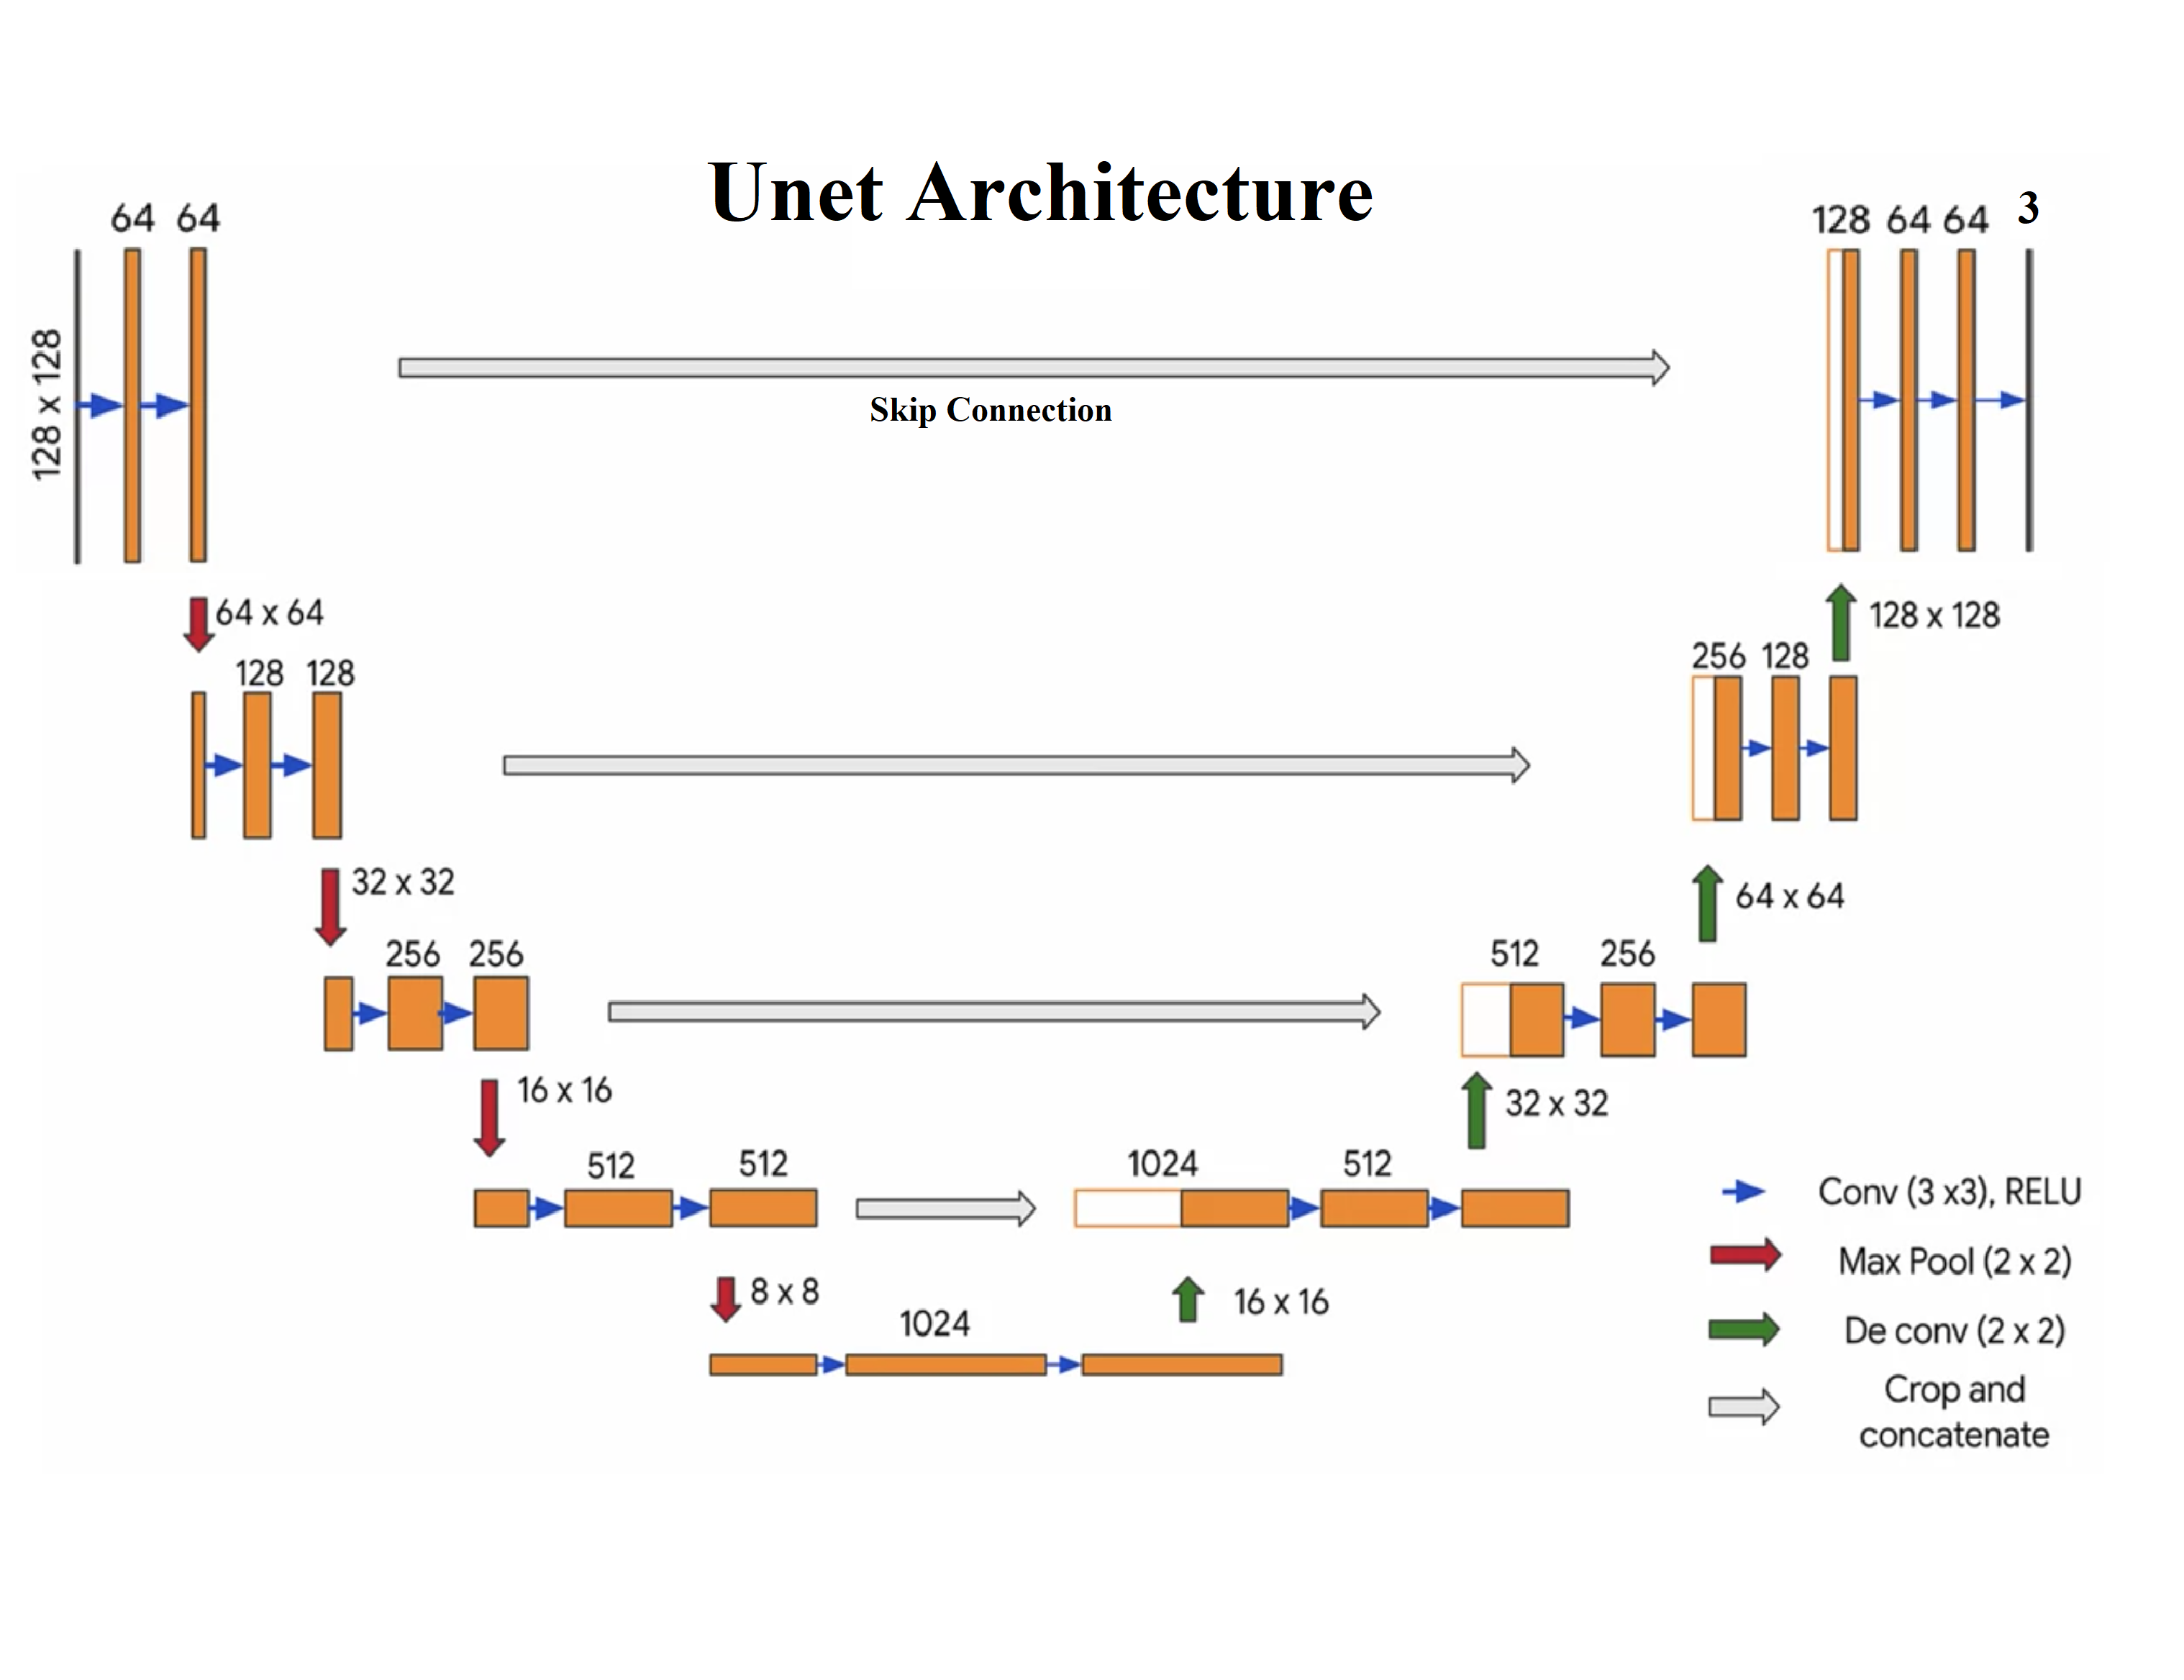
Convolutional neural network U-net structure

Slide 11
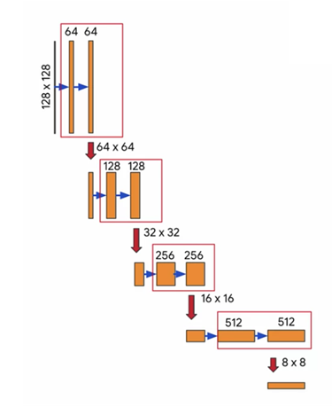
Down-Sampling

Slide 12
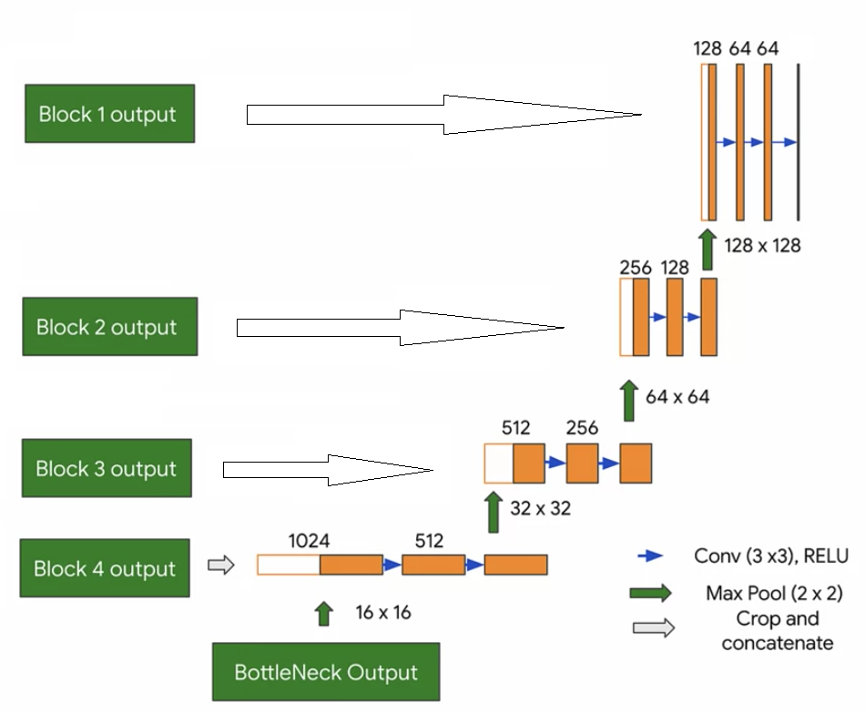
Up sampling

Slide 13
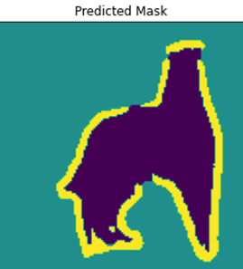
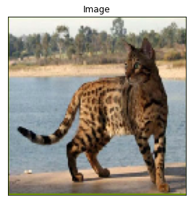
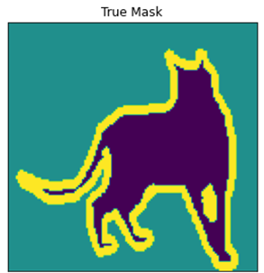
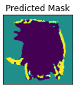
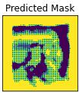
Result
Convolution block
Kernel
(n,n)
(m,m)
Results
Architecture | Ouput image | Accuracy
Kernel – (3*3) n=m=3 dropout =30% |  | 84.05%
Kernel – (3*3) n=m=3 No dropout layer |  | 69.4%
Kernel – (5*5) n=m=5 |  | 63.87%
Input
Label

Slide 14
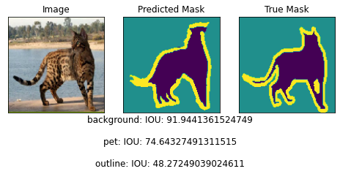
After adding Batch Normalization
Batch of 50 images choosen
Batch normalization applies a transformation that maintains the mean output close to 0 and the output standard deviation close to 1.
the layer will only normalize its inputs during inference after having been trained on data
Accuracy =89%

Slide 15
Summary
Selecting best hyperparameter is very important
Batch normalization optimizes network training
Dropping features in neural network solves the overfitting problem
Skip connection helps to recover lost features while performing down-sampling/max pooling
Unet Architecture works very well in the segmentation domain

Slide 16
Idea
After training on pets can it segment people?

Slide 17
Application
Video segmentation
Demo→

Slide 18
Reference
Paper
Ronneberger, O., Fischer, P. & Brox, T. (2015). U-Net: Convolutional Networks for Biomedical Image Segmentation. Medical Image Computing and Computer-Assisted Intervention – MICCAI 2015, .
CNN Course by DeepLearning.AI

Slide 19
Thank you

